Slide 1
CS 3186
Finite Automata
Section 2.1

Slide 2
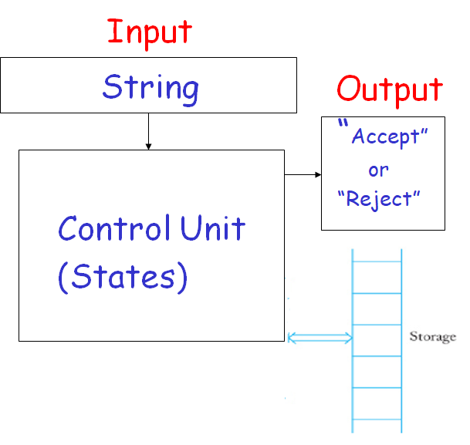
Automaton (Accepter)

Slide 3
Automata (Basic classification)
Automata as an Acceptor
Automata Control unit is a state machine defined by a finite number of states
Storage: No temporary storage
Finite Acceptor is an acceptor with finite number of states and no external storage.

Slide 4
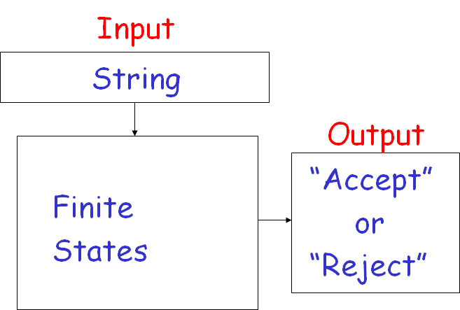
Finite Accepter

Slide 5
Deterministic Finite Accepter (DFA)
DFA:
finite number of states
no external storage
Deterministic configurations
Deterministic: From any state, on the current input, the contents of temporary storage (current configuration), the next state (next configuration) is uniquely defined by one state.

Slide 6
Formalities
Deterministic Finite Accepter (DFA)
M = (Q, ∑,δ, q₀,F)
Q: set of final states
q₀: initial state, q₀∈Q
δ : transition function
∑ : input alphabet
F : set of states, F ⊆ Q

Slide 7
Example
= {a,b}
Q = {q₀, q₁, q₂, q₃, q₄, q₅}
Initial sate = q₀
Final state = {q₄}
δ: Q X ∑ → Q
Transition function defines the next state of the control unit
For example:
δ(q₀, a)= q₁
δ(q₀, b)= q₅

Slide 8
DFA
A deterministic automaton is one in which each move is uniquely determined by the current configuration. If we know the internal state, the input, we can predict the future behavior of the automaton exactly.
(For example, from state q₀ on input b, the next state is q₅; defined by δ(q₀, b)= q₅)
A nondeterministic automaton may have several possible moves, so we can have a set of possible actions.
(For example, from state q₀ on input b, the next state can be q₄ or q₅; defined by δ(q₀, b)= {q₄,q₅})
The relation between deterministic and nondeterministic automata of various types will play a significant role in our study.

Slide 9
Transition Function Representation (Transition Graph)
Transition Graphs constructed as follows:
Vertices represent states
Directed edges represent transitions
Label an edge is current input symbol
Directed edge (q.r) with label a if and only if δ(q, a)= r

Slide 10
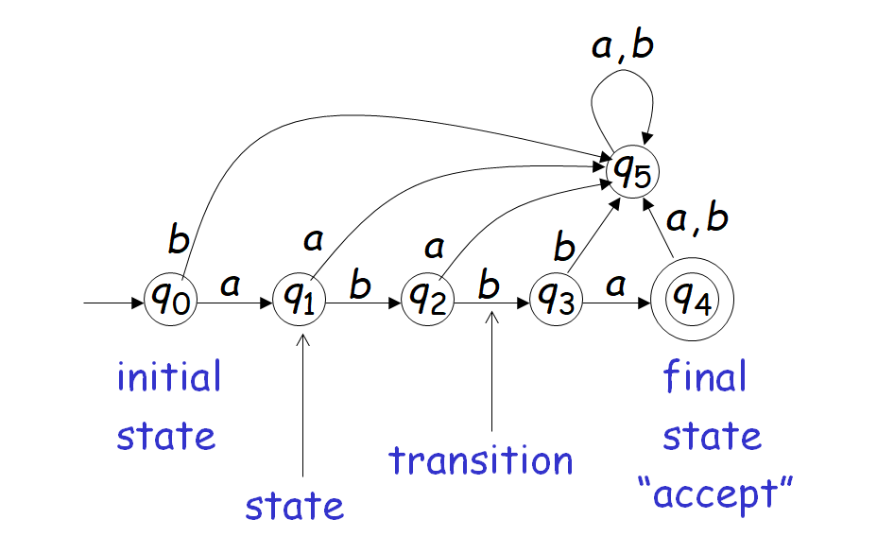
Transition Graph
Example of Finite Accepter

Slide 11
Finite Acceptor
Deterministic Finite Accepter (DFA) Operation
Start with the initial State
While input exists,
CurrentState = δ (CurrentState, CurrentInput)
If CurrentState ∈ F then Accept else Reject

Slide 12
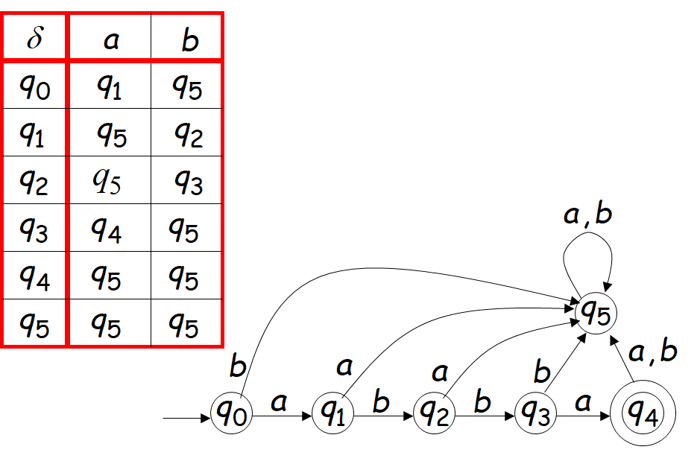
Transition Function δ
can be represented as a
Transition Table or as Transition Graph

Slide 13
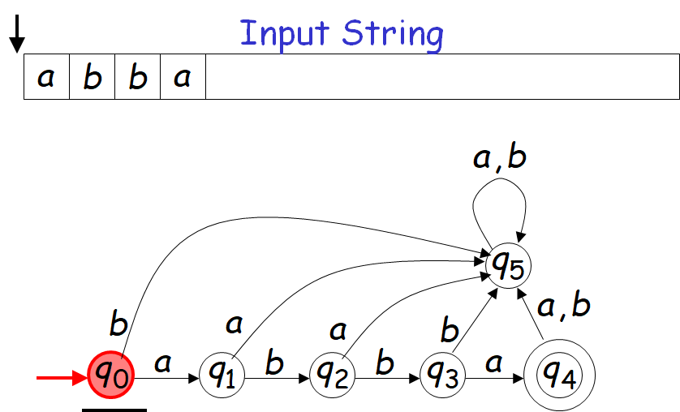
Example 1: DFA operation on an input string

Slide 14
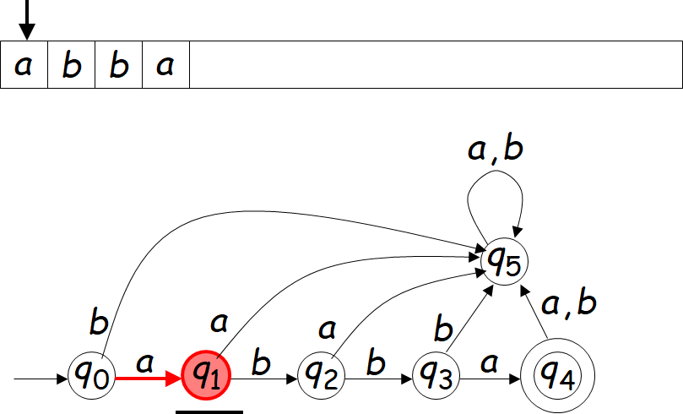
Reading the Input

Slide 15
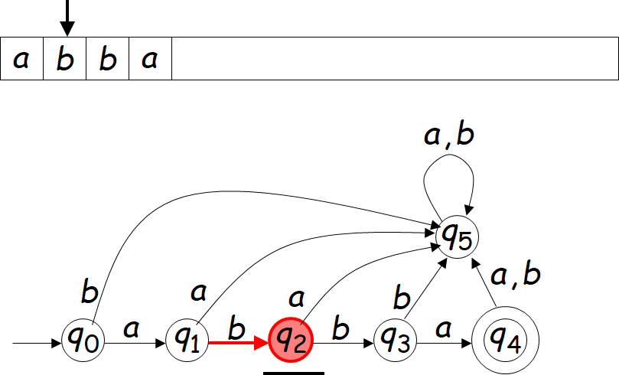

Slide 16
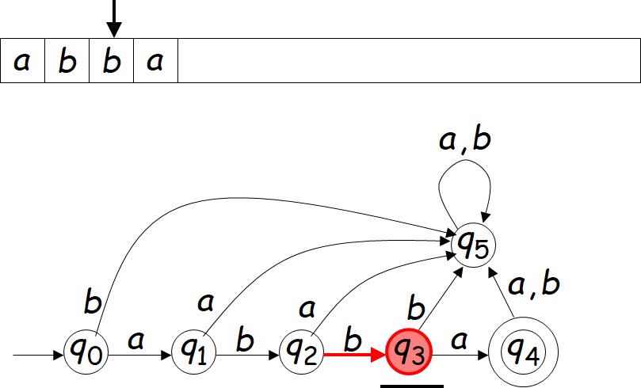

Slide 17
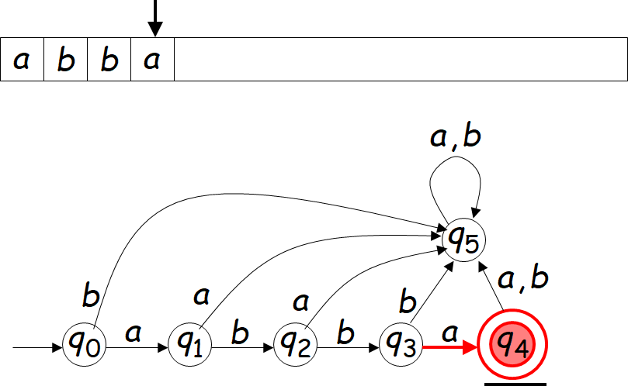

Slide 18
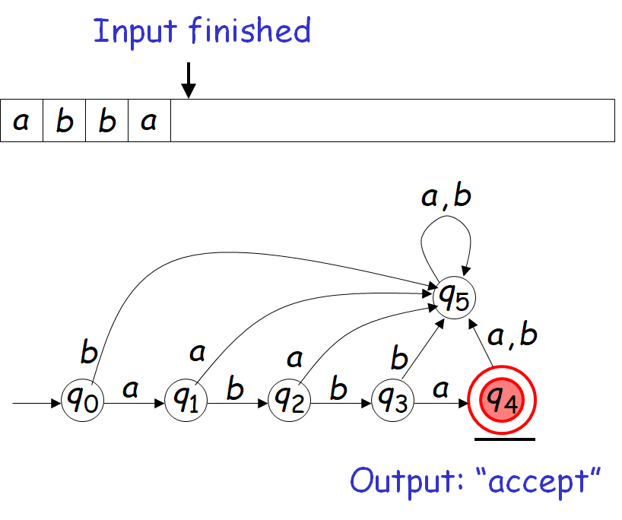

Slide 19
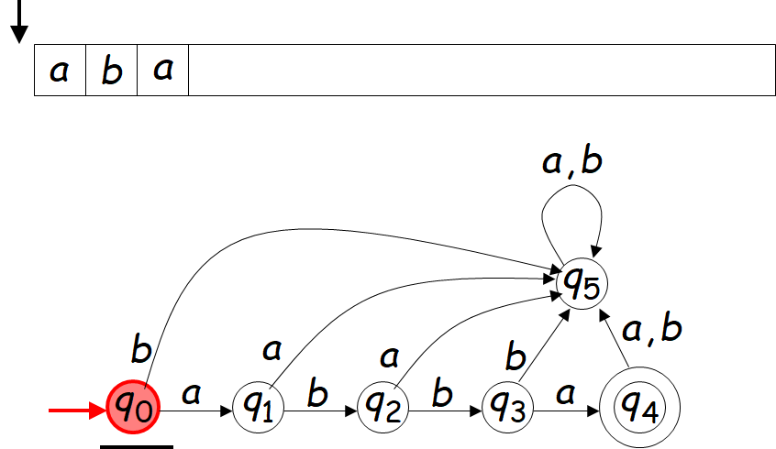
Example 2: DFA rejection on a string

Slide 20
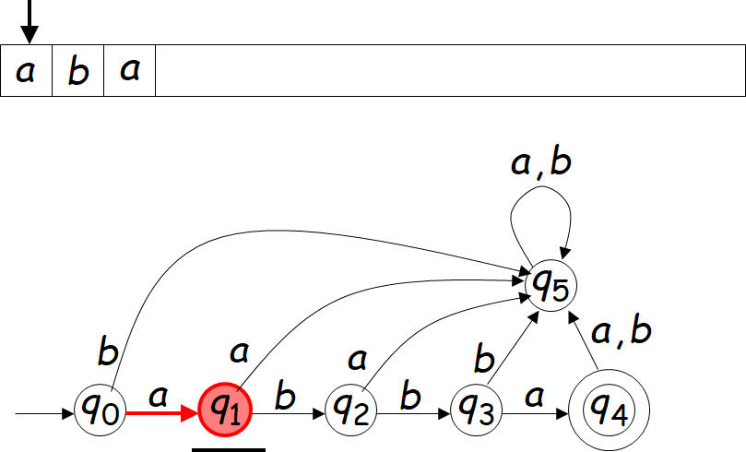

Slide 21
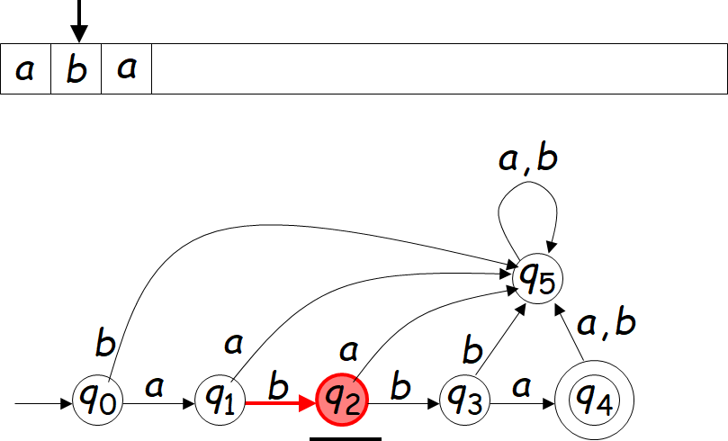

Slide 22
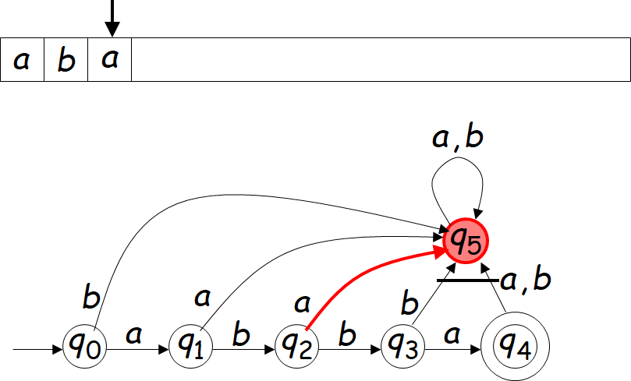

Slide 23
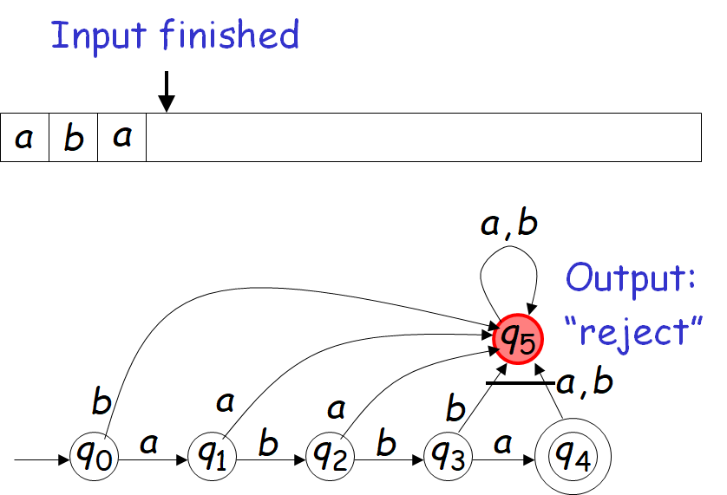

Slide 24
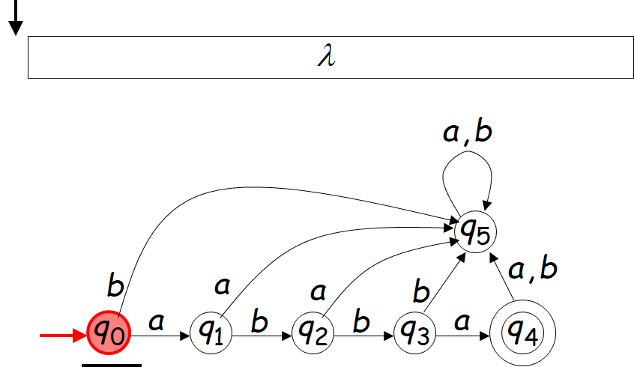
Example 3: DFA operation – another rejection

Slide 25
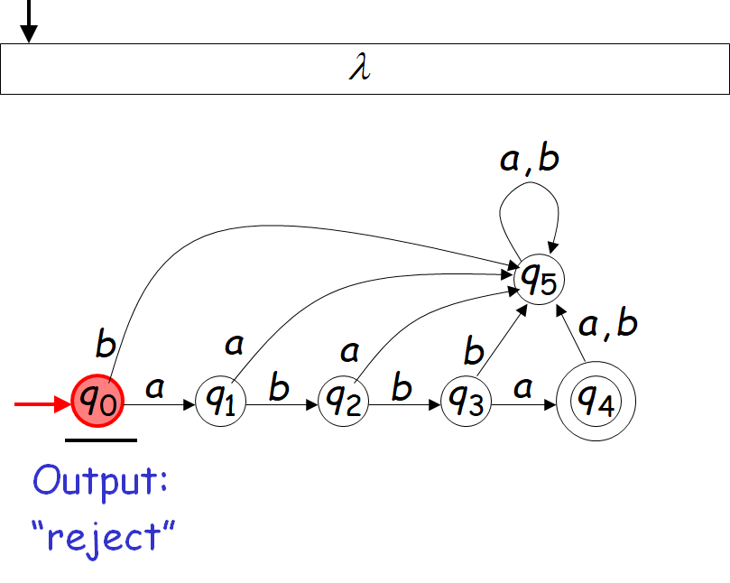

Slide 26
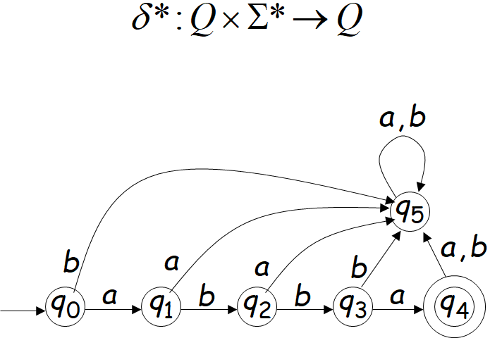
Extended Transition Function

Slide 27
Extended Transition Function δ*
The Extended Transition Function δ* gives the state of the automaton after reading a string

Slide 28
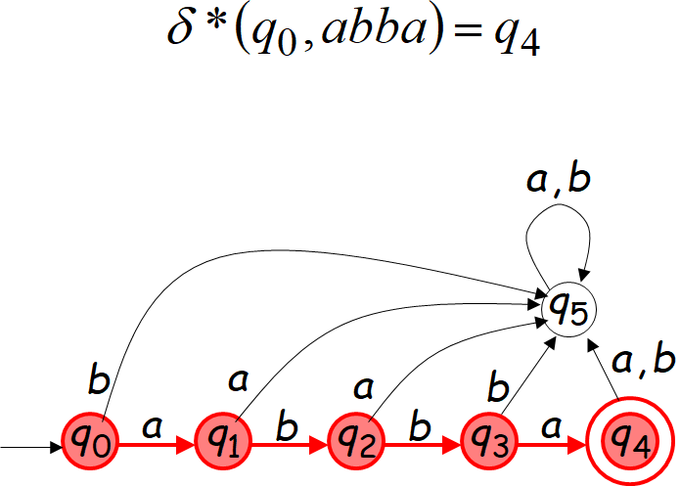
Examples of extended transition functions

Slide 29
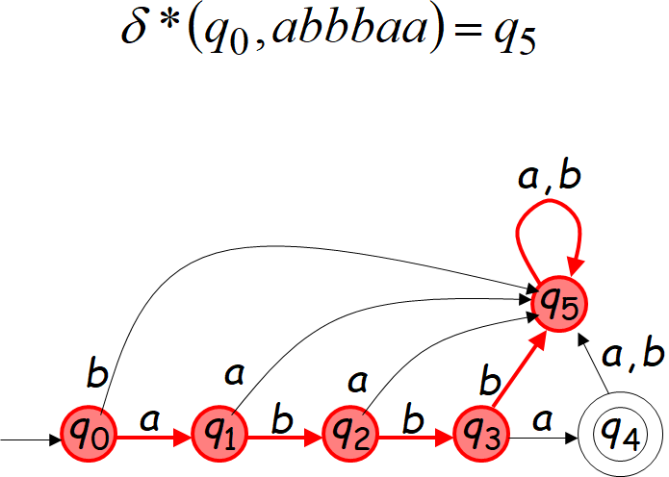

Slide 30
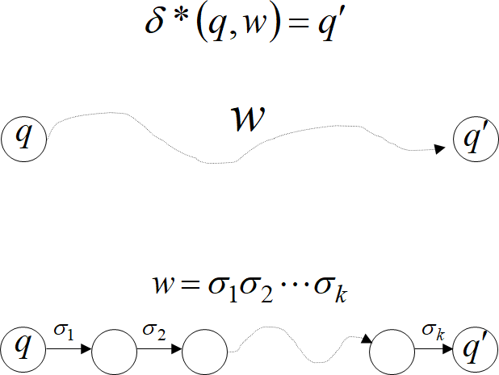
Observation - Walk
Observation: There is a walk from q to q’
with label w

Slide 31
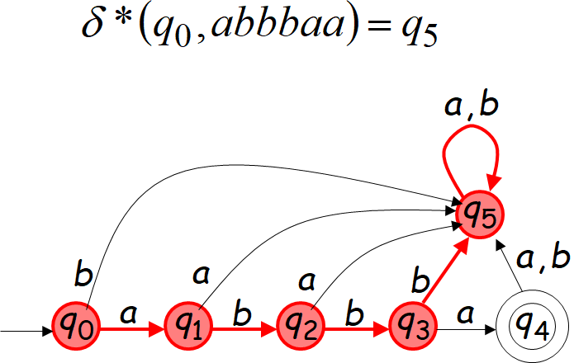
Example - Walk
Example: with label abbbaa

Slide 32
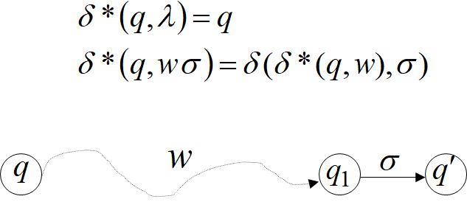
Recursive Definition

Slide 33
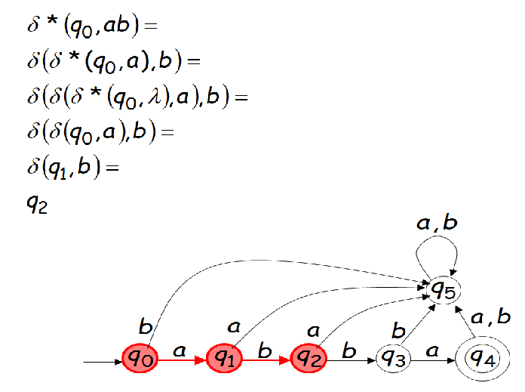
Recursive definition - Example

Slide 34
Languages Accepted by DFAs
Take DFA M
Definition:
The language L(M) contains
all input strings accepted by M
L(M) = { strings that drive M to a final state}

Slide 35
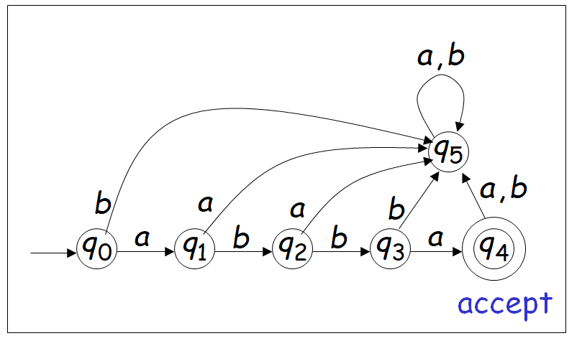
Examples of L(M)
L(M) = {abba} given the following M

Slide 36

Formal definition of L(M)
For a DFA M = (Q, ∑,δ, q₀,F)
Language accepted by M
L(M) = {w ∈ ∑* | δ*(q₀,w) ∈ F}

Slide 37

Another Observation
For a DFA M = (Q, ∑,δ, q₀,F)
Language rejected by M
$\overline{L(M)}$ = {w ∈ ∑* | δ*(q₀,w) ∉F}

Slide 38
Constructing a DFA
Given a given a description of the language in words, Construct a DFA.
We have to employ “reasoning” or “logic” similar to solving a programming problem in Java.
The logic will be slightly tedious as we have to think in terms of the capability of the DFA.
Start with the initial state.
Each state has some meaning to it. i.e., we are “remembering” some information in this state.

Slide 39
Constructing a DFA (Continued)
Given a given a description of the language in words, Construct a DFA.
Construct all other possible states for all possible inputs with an eye on accepting strings in the given language.
Define state transitions based on intuitive logic. Determine the final states that accepts the language.
Give a complete description of
M=(Q, ∑,δ, q₀,F)

Slide 40
Constructing a DFA (Example)
Construct a DFA to accept the language L={abba}
Over ∑ = {a,b}
Note:
The DFA should only accept only the string in the language.
The DFA should account for all possible inputs over ∑ = {a,b}. i.e., any string from
∑*={λ,a,b,aa,ab,ba,bb,aaa,aba,abb…abba,abbb…}
The DFA has to account for the infinite number of strings with finite number of states. (Our thinking process would be similar to designing an algorithm for programming in Java)

Slide 41
Constructing a DFA (Examples)
.

Slide 42
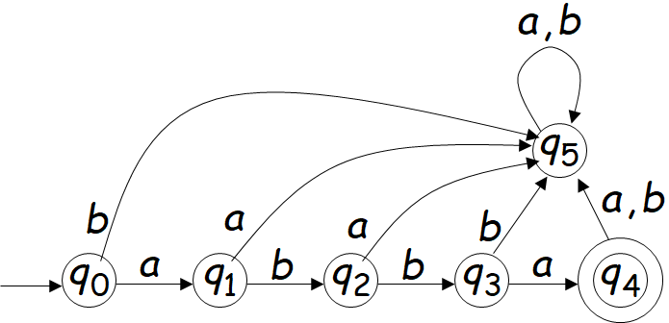
Constructing a DFA (Example 1)
.

Slide 43
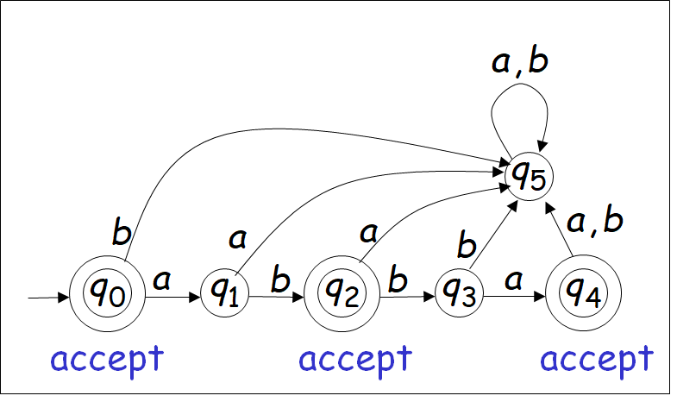
Constructing a DFA (Example 2)
L(M) = {λ,ab,abba}
(Note that the automaton M has F= {q₀,q₂,q₄}

Slide 44
Constructing a DFA (Example 3)
M accepts all strings consisting of arbitrary numbers of a’s followed by a single b. In set notation,
L(M) = {a^{n}b|n ≥ 0}

Slide 45
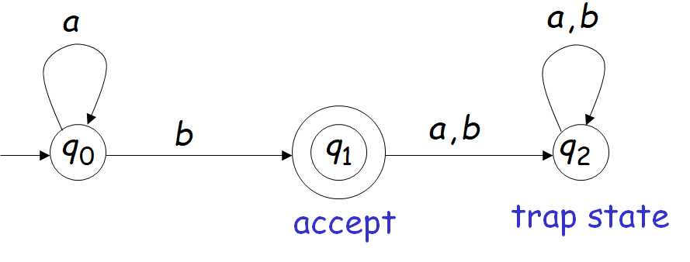
Constructing a DFA (Example 4)
M accepts all strings consisting of arbitrary numbers of a’s followed by a single b. In set notation,
L(M) = {a^{n}b|n ≥ 0}
Note: A trap state is a state from which the automaton can never “escape”.

Slide 46
Constructing a DFA (Example 5)
L(M)={all strings with prefix ab}

Slide 47
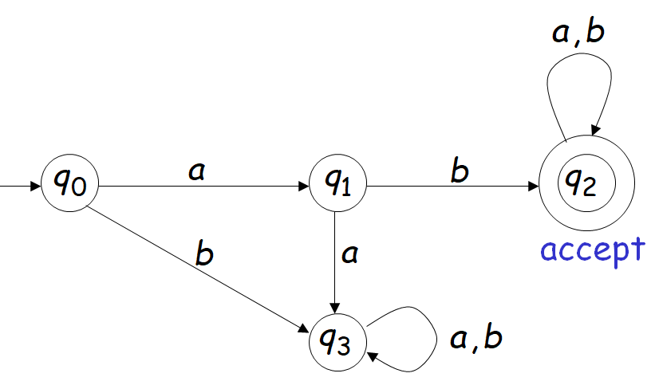
L(M)={all strings with prefix ab}

Slide 48
Constructing a DFA (Example 6)
L(M) = { all strings with substring 001}
∑ = {0,1}

Slide 49
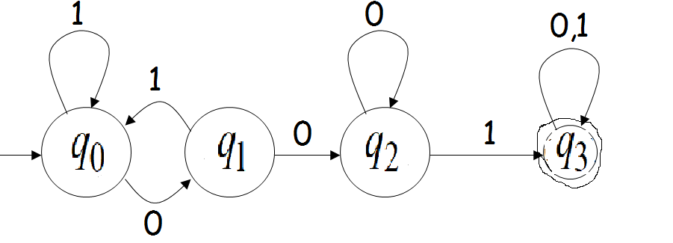
Another Example
L(M) = { all strings with substring 001}
= {0,1}

Slide 50
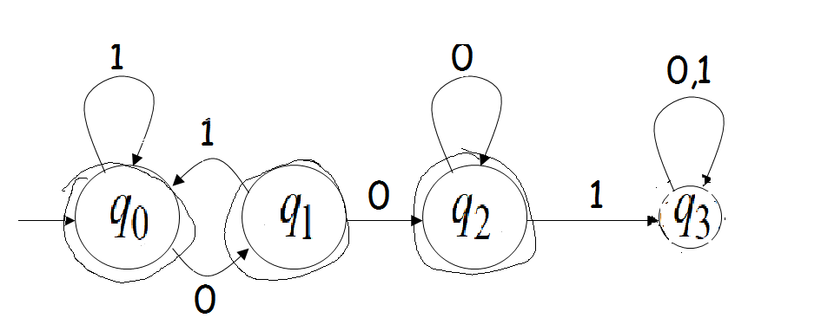
Constructing a DFA (Example 7)
L(M) = { all strings without substring 001}
= {0,1}

Slide 51
Classification or Hierarchy or Family
Languages can be classified based on certain properties of Grammar or Automata.
All the languages which is accepted by some finite automaton are classified as a family of languages. These are referred to as Regular languages.
We will discuss corresponding hierarchy with Grammars in the next chapter.
We will discuss the other level in the language hierarchy later in the course.

Slide 52
Regular Languages
A language L is regular if there is
a DFA M such that L = L(M)
To refer to a given language as Regular, one needs to describe a FSA, M that accepts precisely that language.

Slide 53
Examples of regular languages
{abba}
{λ, ab, abba}
{a^{n}b|n ≥ 0}
{all strings with prefix ab}
{all strings that contain ab}
{all strings without substring 001}
There exist automata that accept these Languages.

Slide 54
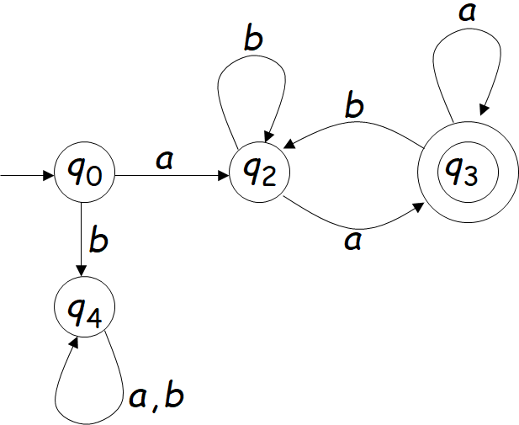
Another example of a Language
The language L = {awa|w∈{a,b}*}
is regular. i.e., all strings that begin and end with an “a”.
L=L(M)

Slide 55
Non regular languages
There exist languages which are not Regular
Example: L ={a^{n}b^{n}|n ≥ 0}
There is no DFA that accepts such a language
We will prove this later in the class
:

Slide 56
Homework 2.1
I) Do exercises : #1 to #6 II) Do exercises : #7 (a to c), #8 (a), #11 (a,b) III) Given the alphabet as {0, 1}, write a DFA for the following regular languages. (i) Give the complete description of the DFA with transition function as a table. (ii) Give two examples in the Language that leads to acceptance. Describe using the extended transition function on a string (of length >=4) recursively using transitions one symbol at a time. (iii) Give two examples that are not in the Language that is not accepted. Describe using the extended transition function on a string (of length >=4) recursively using transitions one symbol at a time.

Slide 57
Homework 2.1 (continued)
L = {w | w has exactly a single 1}
L = {w | w has at least one 1}
L = {w | w contains the string 01 as a substring}
L = {w | w is a string of odd length}
L = {w | the length of w is a multiple of three}
L = {w | w starts and ends with the same symbol}
L = {w | w ends in 11}
L = {w | w has at least one pair of consecutive zeroes}
L = {w | w has no pair of consecutive zeroes}
L = {w | w contains the substring 011}
L = {w | w is a string with an even number of 0’s}
L = {w | w does not contain the substring 110}
L = { w | w does not have even number of 1’s}

